Slide 1
Incomplete Dominance

Slide 2
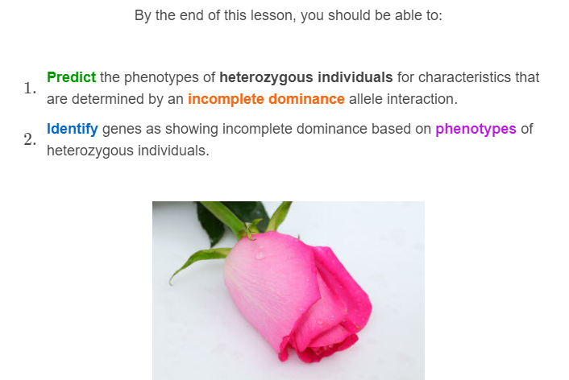

Slide 3
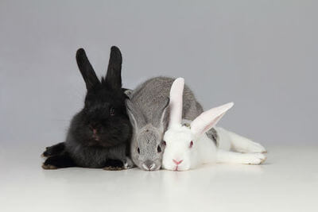
Incomplete dominance is another type of allele interaction.
In incomplete dominance, neither allele completely hides the other, so neither are dominant or recessive.
Instead, both alleles contribute to the final phenotype. Individuals with one of each allele show a new, intermediate phenotype.

Slide 4


Slide 5
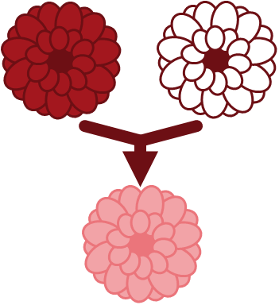
When individuals are heterozygous for a gene that shows incomplete dominance, they will have a blended phenotype.
This means that they will look like a blend (or intermediate) of the two different alleles!
If an individual is homozygous for a gene that shows incomplete dominance, they will express the allele that they are homozygous for.
Because of this, neither trait is considered dominant.

Slide 6

We can see incomplete dominance in the flower colour of roses.
If you breed a homozygous red rose with a homozygous white rose their heterozygous offspring will be pink!
The pink phenotype is new. It is an intermediate of the red and white phenotypes.

Slide 7
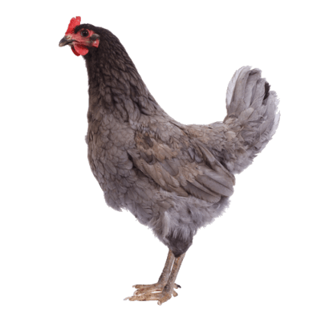
Another example of incomplete dominance is seen in the Andelusian chicken breed.
Their feather colour is controlled by one gene with an allele for black feathers and an allele for white feathers.
Individuals with two alleles coding for black feathers get black feathers. Two alleles for white feathers produces a white chicken. However, one of each allele produces a steely grey bird.

Slide 8
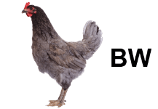
When discussing incomplete dominance, you use a different allele notation than when discussing dominant/recessive interactions.
Both alleles are given capital letters. This shows that neither is truly recessive. To differentiate between alleles, we give them different letters.
In the case of the Andelusian chicken, we can give the allele that codes for black feathers a capital B and the allele that codes for white feathers a capital W.

Slide 9
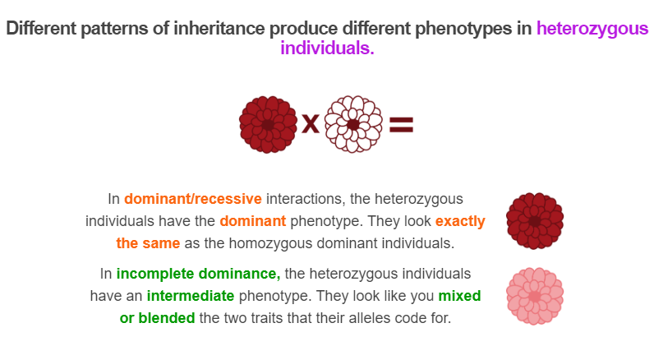

Slide 10
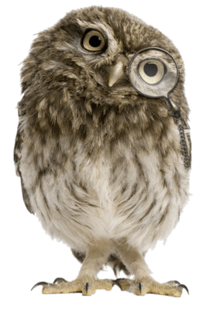
It is important to practice identifying examples of incomplete dominance.
If a homozygous curly-feathered bird is crossed with a homozygous straight-feathered bird, they produce heterozygous wavy-feathered offspring.
Wavy feathers are half way between curly and straight.

Slide 11
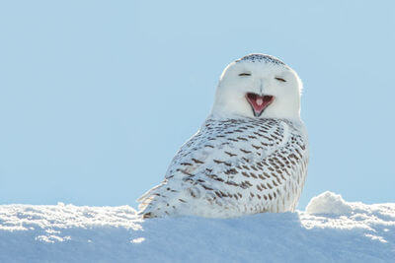
Yes! The shape of the feathers is an example of incomplete dominance.
This is evident as the wavy trait is halfway between the curly and the straight. It is a new, intermediate phenotype.

Slide 12
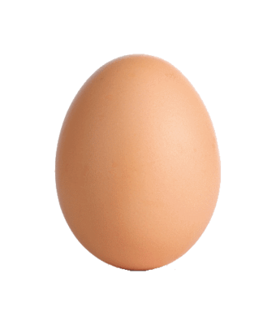
Here is another practice question:
One homozygous bird lays eggs with blue spots. Another homozygous bird lays eggs with red spots.
Heterozygous individuals lay eggs with blue and red spots.

Slide 13
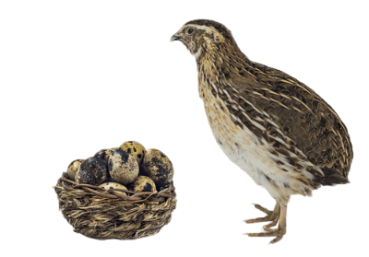
No! This is not an example of incomplete dominance.
We know this because both traits coexist side by side. The heterozygous individuals have both red and blue spots on their eggs.
If this were incomplete dominance, then the spots would be purple or some other intermediate colour.

